Slide 1




Celebrating the value and impact of AHP Research and Innovation!
Our Virtual Poster Gallery Brochure Themes
Evaluating student experiences and perceptions of research engagement
Promoting research engagement and capacity building in the wider workforce
Collaborative partnership working, including with service users
Building research capability, leadership and roles
Improving care quality & service delivery
Browse our Gallery Brochure
Note the Poster ID number
View the Posters in our Virtual Gallery

Slide 2
Celebrating the value and impact of AHP Research and Innovation!
Our Virtual Poster Gallery Brochure Themes
Evaluating student experiences and perceptions of research engagement
Promoting research engagement and capacity building in the wider workforce
Collaborative partnership working, including with service users
Building research capability, leadership and roles
Improving care quality & service delivery
Browse our Gallery Brochure
Note the Poster ID number
View the Posters in our Virtual Gallery

Slide 3
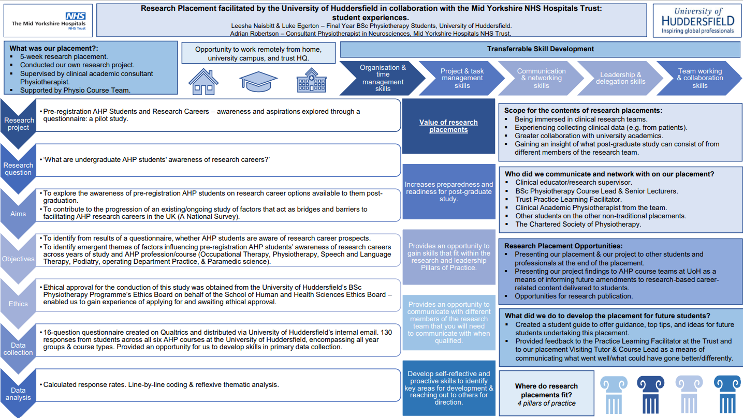
Research Placement facilitated by the University of Huddersfield in collaboration with the Mid Yorkshire NHS Hospitals Trust: student experiences.
Value & Impact of AHP engagement:
Transferable skills that fit within the research and leadership pillars of practice as well as further preparing us to be evidence-based practitioners when working clinically.
Increased our preparedness and readiness for post-graduate study and research.
Communication with multiple different professionals and organisations, allowing for networking and access to the skills and expertise of others.
Professions: Physiotherapy
Contact: leesha.naisbitt@gmail.com / adrian.robertson@nhs.net
Poster ID: 1, 1
https://www.youtube.com/watch?v=Ex0l27Nks6I -

Slide 4
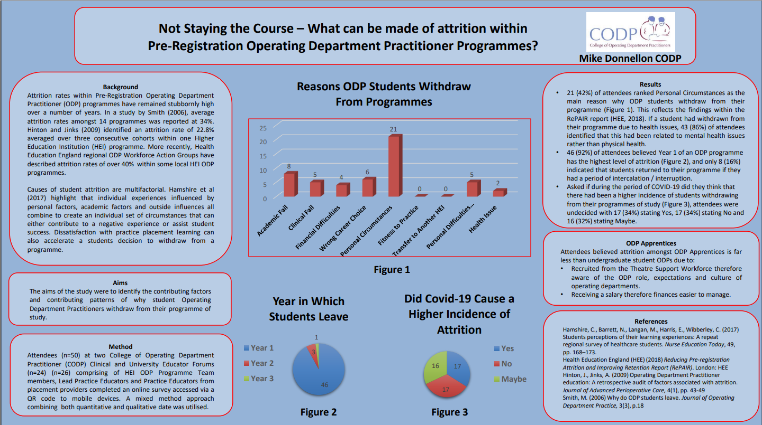
Not Staying the Course: What can be made of attrition within Pre-Registration Operating Department Practitioner Programmes
Value & Impact of AHP engagement:
Adopt robust research approaches to evaluate and understand experiences of student Operating Department Practitioners
Identify contributing patterns of Student Operating Department Practitioner attrition
Develop strategies to reduce attrition within Pre-Registration Operating Department Practitioner Programmes
Professions: Operating Department Practitioners
Contact: mike.donnellon@codp.org.uk
Poster ID: 1, 2

Slide 5
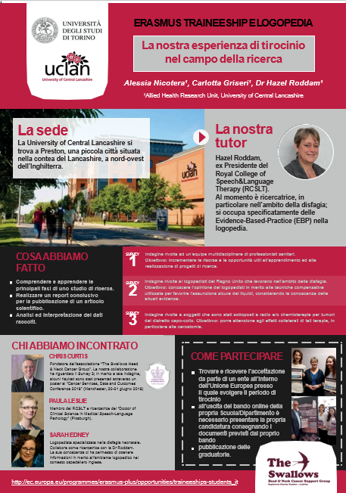
La nostra esperienza di tirocinio nel campo della ricerca
(Our research internship experience)
Value & Impact of AHP engagement:
Experiential learning of research processes
Analysis and interpretation of research data
First prize for research posters at European Society of Medical Oncology 2018 and UK Cancer and Data Outcomes conference 2018
Professions: Speech and Language Therapy
Contact: alessianicotera86@gmail.com
Poster ID: 1, 3

Slide 6
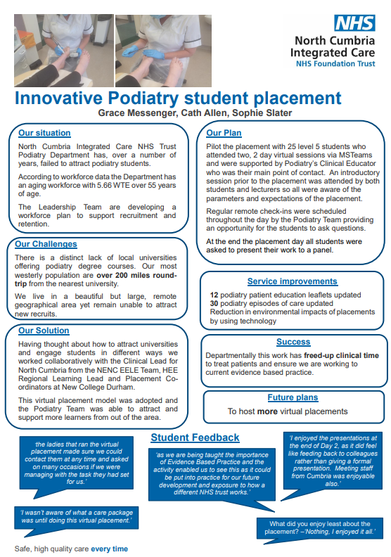
Innovative Podiatry student placements
Value & Impact of AHP engagement:
Innovative placement to attract hard to recruit students
Quick turnaround of service improvement work
Improved links with HEI
Professions: Podiatry
Contact: Grace.Messenger@ncic.nhs.uk
Poster ID: 1, 4

Slide 7
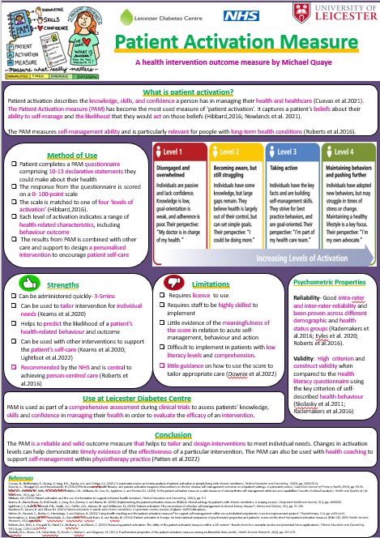
Patient Activation Measure – a student led review of a clinical resource
Poster ID: 1, 5
Value & Impact of AHP engagement:
Hosting and supporting AHP students within different settings such as research, can help develop their research skills and engage them in different avenues of practice
Physio students developed a poster as part of their placement
to help assess effectiveness of interventions and help tailor interventions to individual needs
Professions: Physiotherapy
Contact: Vicki.Johnson@uhl-tr.nhs.uk

Slide 8
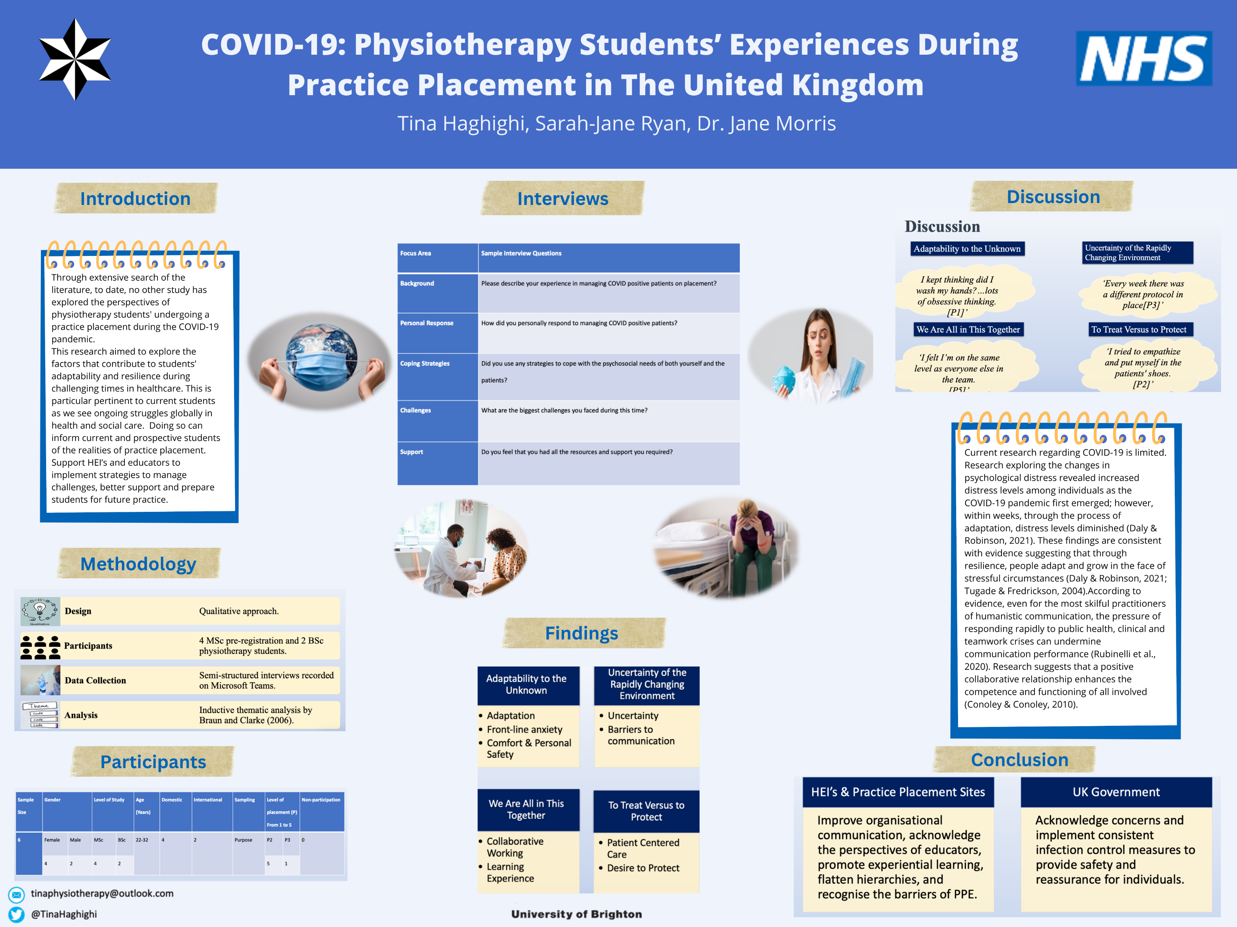
COVID-19: Physiotherapy Students’ experiences during practice placements in the United Kingdom
Poster ID: 1, 6
Value & Impact of AHP engagement:
Insights to student experiences during extreme periods of pressure in health and social care services
Understanding students’ support needs for ongoing challenging periods in service delivery
Professions: Physiotherapy
Contact: s.j.ryan@brighton.ac.uk / T.Haghighi1@uni.brighton.ac.uk

Slide 9
Celebrating the value and impact of AHP Research and Innovation!
Our Virtual Poster Gallery Brochure Themes
Evaluating student experiences and perceptions of research engagement
Promoting research engagement and capacity building in the wider workforce
Collaborative partnership working, including with service users
Building research capability, leadership and roles
Improving care quality & service delivery
Browse our Gallery Brochure
Note the Poster ID number
View the Posters in our Virtual Gallery

Slide 10
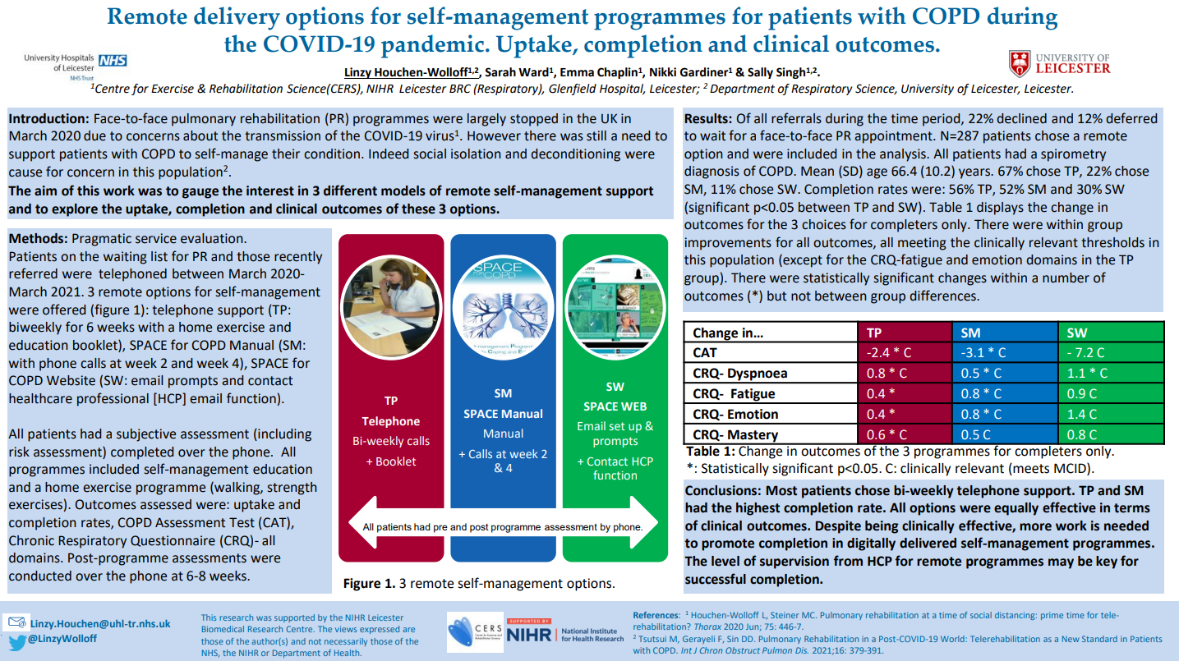
Remote delivery options for self-management programmes for patients with COPD during the COVID-19 pandemic. Uptake, completion and clinical outcomes.
Poster ID: 2, 1
Value & Impact of AHP engagement:
Resilience of team to continue to support patients during the pandemic
Access to ready to implement interventions from previous research
Promoted patient self-management
Professions: Physiotherapy, Nursing
Contact: Linzy.Houchen@uhl-tr.nhs.uk

Slide 11
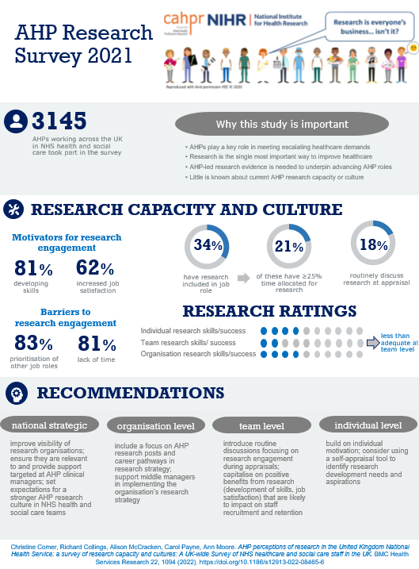
Allied Health Professionals’ Perceptions of Research in the United Kingdom National Health Service: a survey of research capacity and culture
Poster ID: 2, 2
Value & Impact of AHP engagement:
Evidence of need for organisational level focus on AHP research posts, career pathways & clinical academic joint contracts
Need for team-level routine discussions focusing on research engagement to capitalise on positive benefits from research activity identified by AHPs
Need for individual-level support for generation of new
knowledge and implementation of research
Professions: All 14 allied health professions recognised by HEE
Contact: c.comer@nhs.net

Slide 12
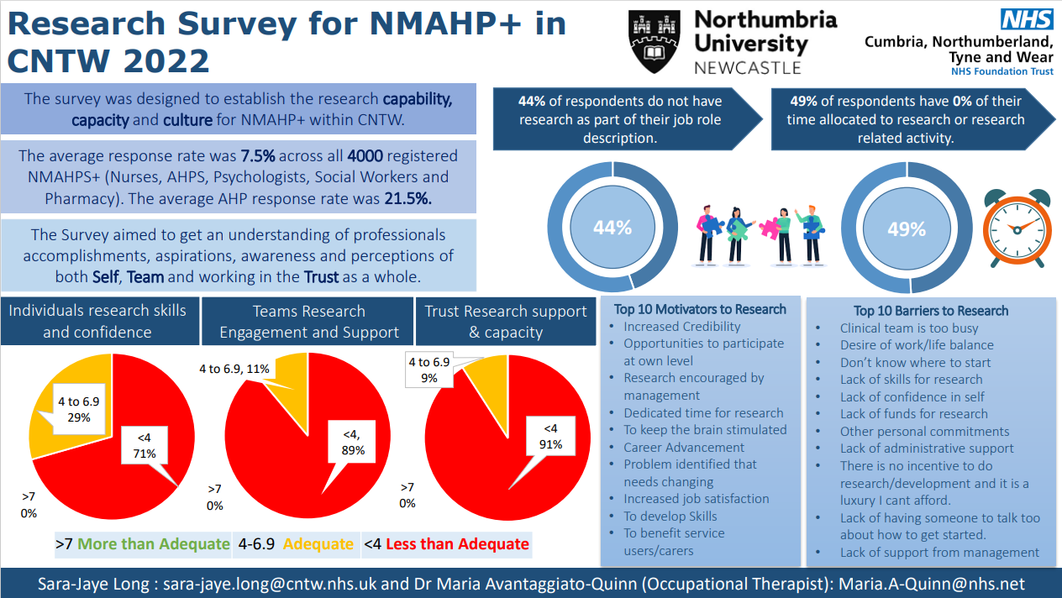
Research Survey for NMAHP+ in Cumbria, Northumberland, Tyne & Wear (CNTW) 2022
Poster ID: 2, 3
Value & Impact of AHP engagement:
Insights of professionals’ research skills and confidence
Evidence of teams’ research engagement and access to support
Evidence of specified responsibility for research-related roles in job descriptions
Professions: AHPs, Nursing, Psychology, Social Work, Pharmacy
Contact: Maria.A-Quinn@nhs.net

Slide 13
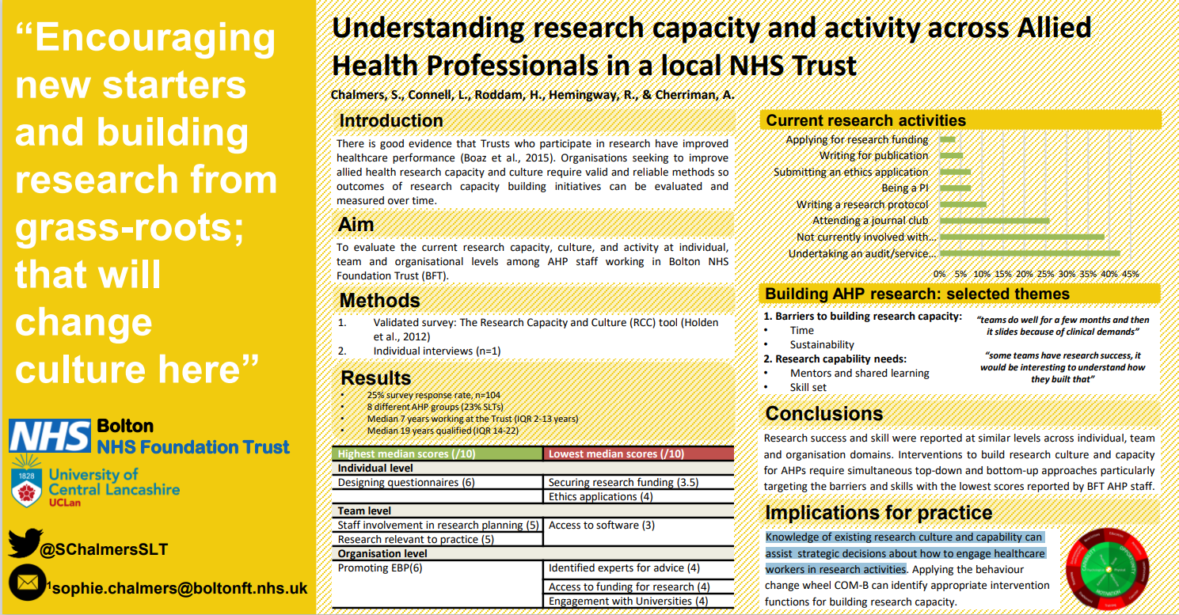
Understanding research capacity and activity across Allied Health Professionals in a local NHS Trust
Poster ID: 2, 4
Value & Impact of AHP engagement:
Evidence of local research culture and capability to support strategic decisions about how to engage healthcare workers in research activities
Comparative levels of staff engagement in clinical audit and service evaluations versus formal research activities
Professions: 8 AHP disciplines
Contact: Sophie.Chalmers@boltonft.nhs.uk

Slide 14
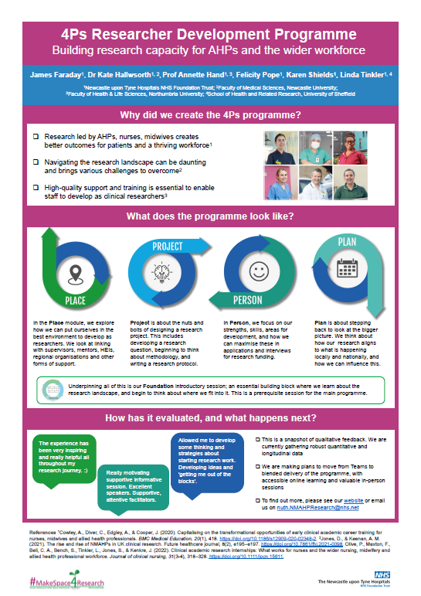
4Ps Researcher Development Programme: Building research capacity for AHPs and the wider workforce
Value & Impact of AHP engagement:
Development of research skills, knowledge and confidence for AHPs and the wider workforce
Embedding of research awareness across the organisation
Increased confidence for AHP and other colleagues to pursue a clinical academic career
Professions: Dietetics, Physiotherapy, Podiatry, Speech and Language Therapy, Nursing, Midwifery, Workforce Development, Administration
Contact: james.faraday@nhs.net
Poster ID: 2, 5

Slide 15
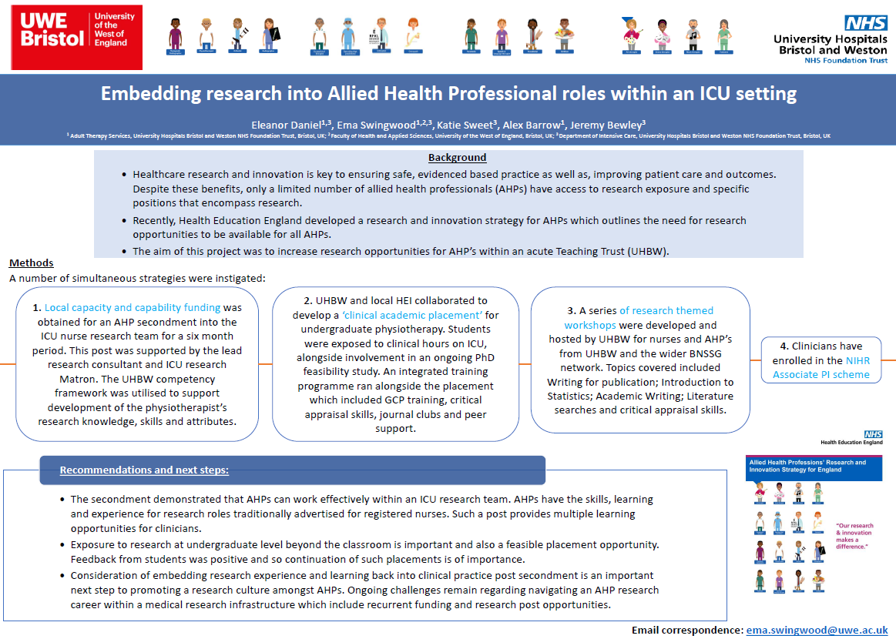
Embedding research into Allied Health Professional roles within an ICU setting
Value & Impact of AHP engagement:
Evidence that AHPs can work effectively within an ICU research team
Positive student feedback highlights the feasibility of pre-registration placement experiences
Clinical practice secondment opportunities increase a positive research culture for the AHP workforce
Professions: AHPs in an Acute Teaching Trust
Contact: Ema.Swingwood@uwe.ac.uk
Poster ID: 2, 6
Please add image of poster here, I am unable to resize it

Slide 16
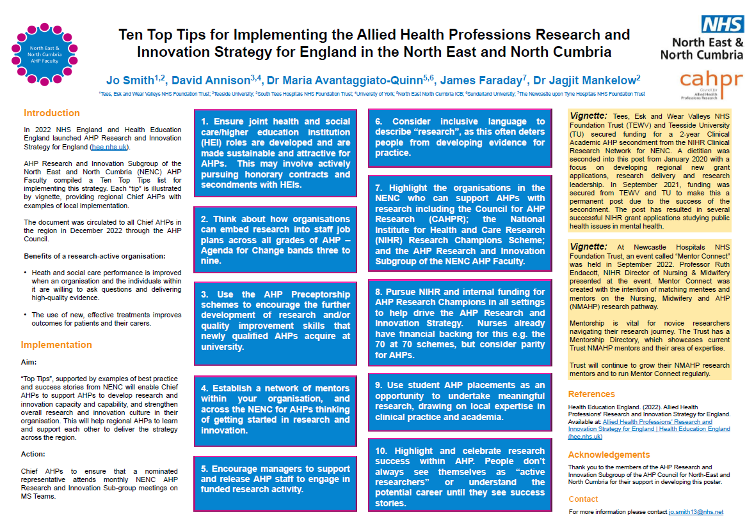
Ten Top Tips for Implementing the Allied Health Professions Research and Innovation Strategy for England in the North East and North Cumbria
Value & Impact of AHP engagement:
The project will enable Chief AHPs to support AHPs to develop research and innovation capacity and capability, and strengthen overall research and innovation culture in their organisation
The project will help regional AHPs to learn and support each other to deliver the AHP R&I strategy across the region
Professions: Dietetics, Occupational Therapy, Physiotherapy, Speech and Language Therapy
Contact: james.faraday@nhs.net
on behalf of the Research and Innovation Subgroup of the AHP Faculty for the North East and North Cumbria
Poster ID: 2, 7
Please add image of poster here, I am unable to resize it

Slide 17

Healthcare Professionals in Research: Facebook Community
Value & Impact of AHP engagement:
Peer support group for pre-doctoral, doctoral, and post-doctoral individuals in healthcare who are looking to embed research into a clinical role
Signposting to opportunities and resources
supportive events such as writing groups
Professions: AHP, Nursing, Midwifery, Healthcare Science, Pharmacy, Psychology
Contact: ruth.barker@wessexahsn.net
Poster ID: 2, 8

Slide 18
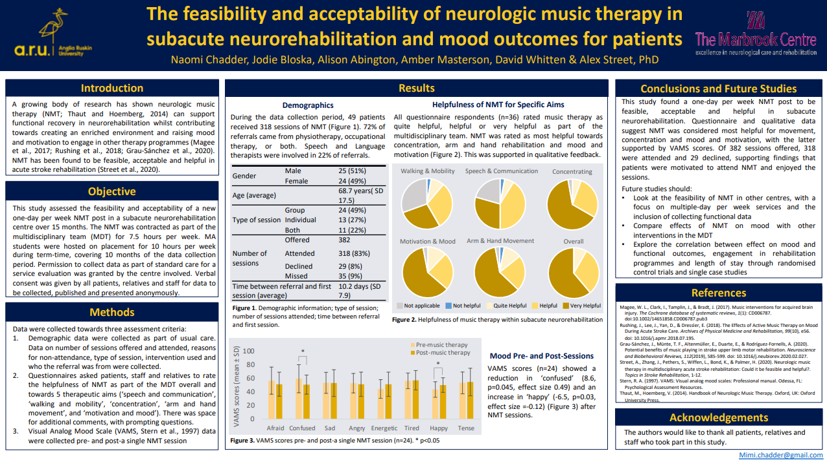
The feasibility and acceptability of neurologic music therapy in subacute neurorehabilitation and mood outcomes for patients
Poster ID: 2, 9
Value & Impact of AHP engagement:
Enhancing patient experience of sub-acute stroke rehabilitation
Implementing a new neurologic music therapy service
AHPs are able to understand the mechanisms of the music-based exercises, make referrals and help develop and deliver exercises on the wards
Professions: Neurologic Music Therapy, Speech and Language Therapy, Physiotherapy, Occupational therapy
Contact: Jodie.Bloska@aru.ac.uk

Slide 19
Celebrating the value and impact of AHP Research and Innovation!
Our Virtual Poster Gallery Brochure Themes
Evaluating student experiences and perceptions of research engagement
Promoting research engagement and capacity building in the wider workforce
Collaborative partnership working, including with service users
Building research capability, leadership and roles
Improving care quality & service delivery
Browse our Gallery Brochure
Note the Poster ID number
View the Posters in our Virtual Gallery

Slide 20
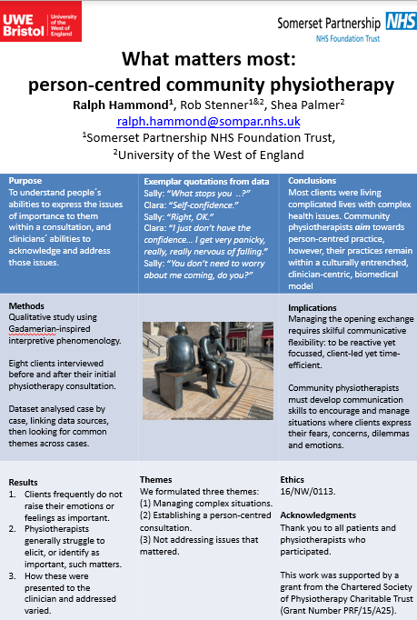
What matters most: person-centred community physiotherapy
Poster ID: 3, 1
Value & Impact of AHP engagement:
Strengthening/building partnership working between clinical practitioners and academic partners
Encouraging evaluation of local practice/service delivery
Professions: Physiotherapy
Contact: Ralph.Hammond@SomersetFT.nhs.uk

Slide 21
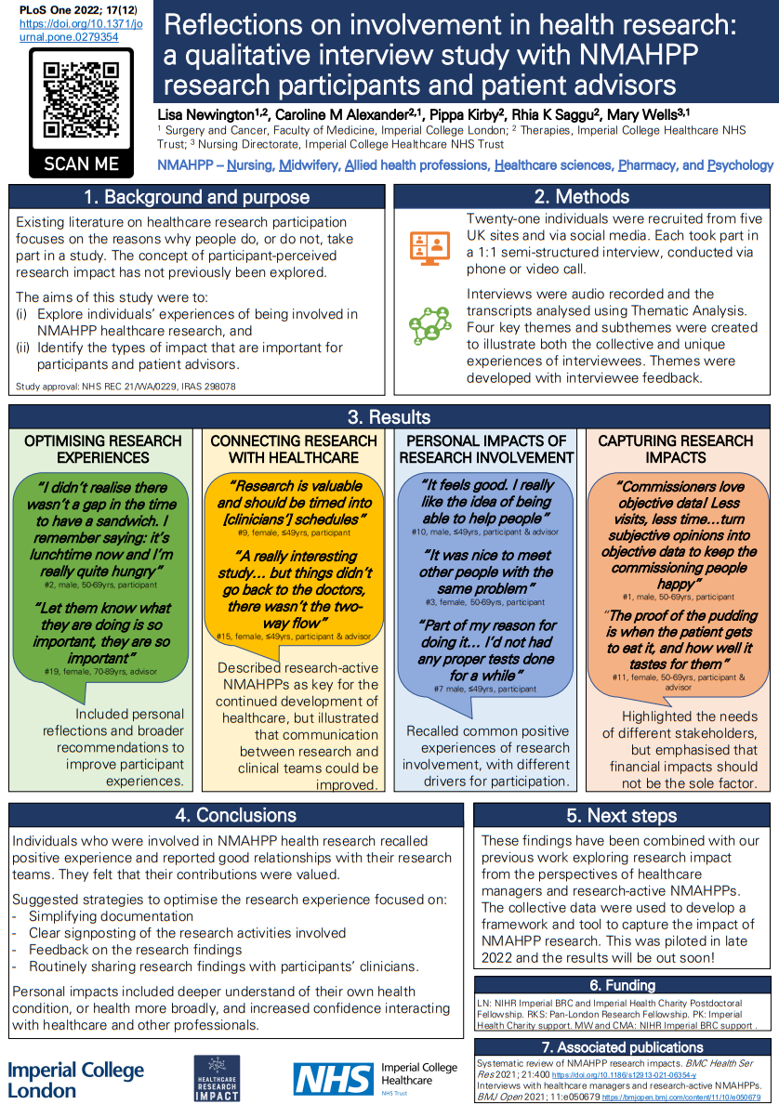
Reflections on involvement in health research: a qualitative interview study with NMAHPP research participants and patient advisors
Poster ID: 3, 2
Value & Impact of AHP engagement:
Evidence of positive experiences and reported good relationships with their research teams
Suggested strategies to optimise the research experience of participants
Personal impacts for those contributing to research included deeper understanding of their own health condition and increased confidence interacting with healthcare and other professionals
Professions: Physiotherapy, Dietetics, Speech and Language Therapy, Nursing
Contact: l.newington@imperial.ac.uk

Slide 22
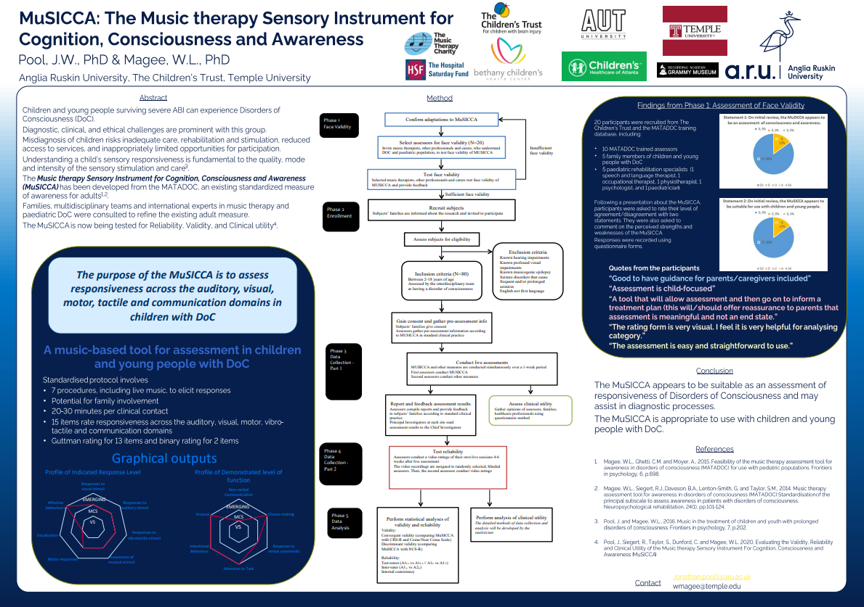
MuSICCA: The Music therapy Sensory Instrument for Cognition, Consciousness and Awareness
Value & Impact of AHP engagement:
The first validated music-based measure for diagnosis and treatment planning for children and young people with disorders of consciousness, optimising treatment and improving recovery
To be shared globally with music therapists to make it as widely available as possible
Provides guidance on involving family caregivers, empowering the family
Professions: Music Therapy, Psychology, Medicine, Occupational Therapy, Physiotherapy, Speech and Language Therapy.
Contact: jonathan.pool1@aru.ac.uk
Poster ID: 3, 3

Slide 23
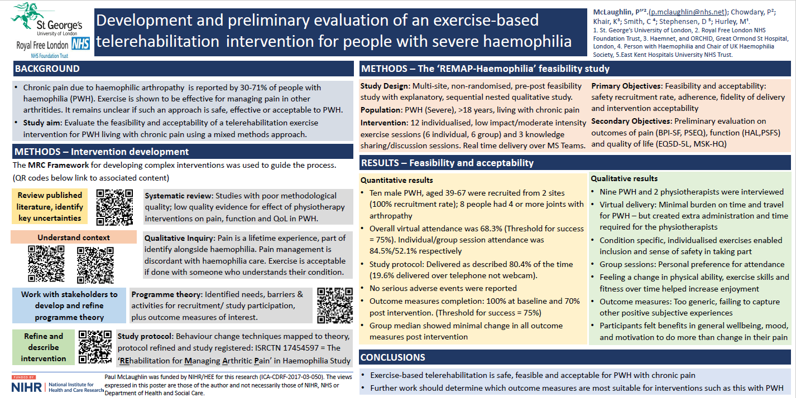
Development and preliminary evaluation of an exercise-based telerehabilitation intervention for people with severe haemophilia
Value & Impact of AHP engagement:
Highlighted what people with haemophilia want in their clinic reviews with regard to assessment of their pain
Evidenced the limitations of current physiotherapy approaches to pain management and identified further areas of need for investigation
Involvement of people with lived experience generated significant benefits, particularly in creating an intervention that people felt ‘fitted’ for them and their rare disorder
Professions: Physiotherapy
Contact: p.mclaughlin@nhs.net
Poster ID: 3, 4
Please add image of poster here, I am unable to resize it

Slide 24
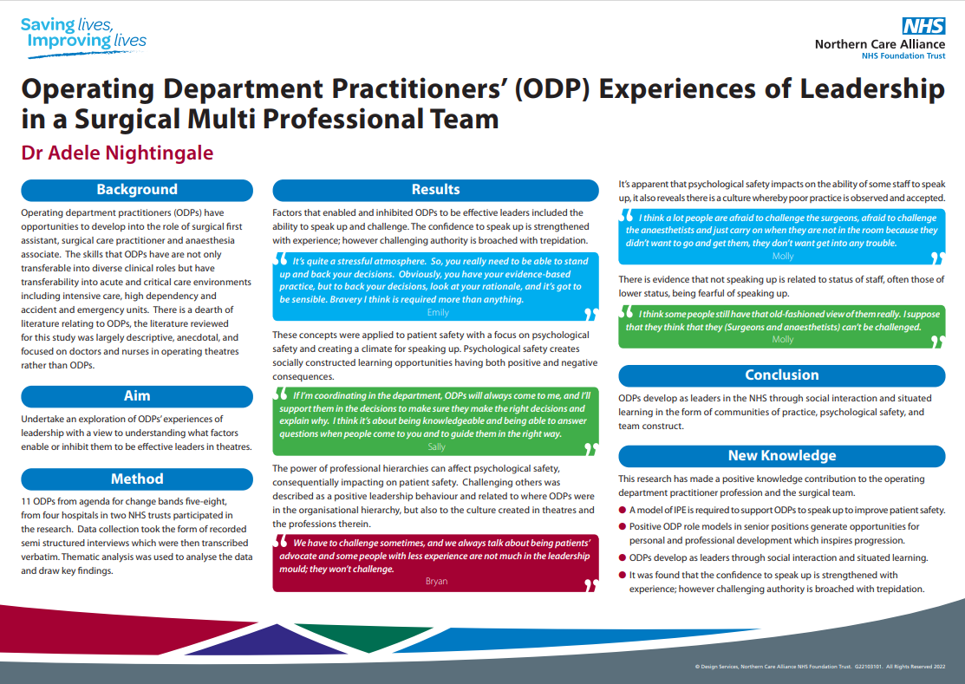
Operating Department Practitioners’ (ODP) Experiences of Leadership in a Surgical Multi Professional Team.
Poster ID: 3, 5
Value & Impact of AHP engagement:
Research findings used to inform future NHSE Building Outstanding Theatre Teams leadership and culture workstream
Evidence of ODP research capability
Influencing national the development of the NIHR Advanced Surgical Technology Incubator group
Professions: Operating Department Practitioners, Surgical teams
Contact: Adele.nightingale2@pat.nhs.uk

Slide 25
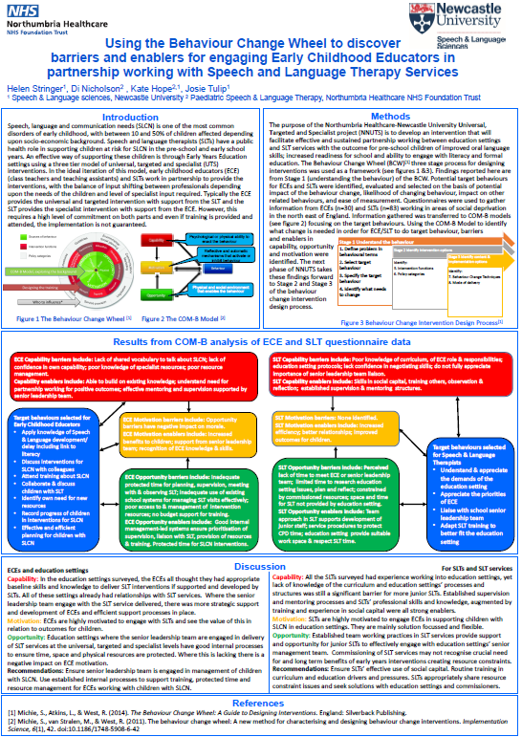
Using the Behaviour Change Wheel to discover barriers and enablers for engaging Early Childhood Educators in partnership working with Speech and Language Therapy Services
Poster ID: 3, 6
Value & Impact of AHP engagement:
Facilitating effective and sustained partnership working between education settings and SLT services
Improving oral language skills for pre-school children
Increasing school readiness
Professions: Speech and Language Therapy
Contact: helen.stringer@ncl.ac.uk

Slide 26
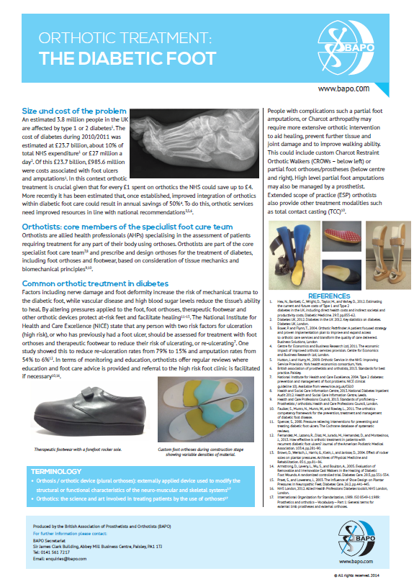
Orthotic Treatment - The Diabetic Foot
Value & Impact of AHP engagement:
Impact on services demonstrating benefit of orthotists involvement in diabetic foot care
Wider capacity building in promoting multi-disciplinary working with other AHP and clinical colleagues
Professions: Prosthetists, Orthotists
Contact: Miriam.Golding-Day@bapo.com
Poster ID: 3, 7

Slide 27
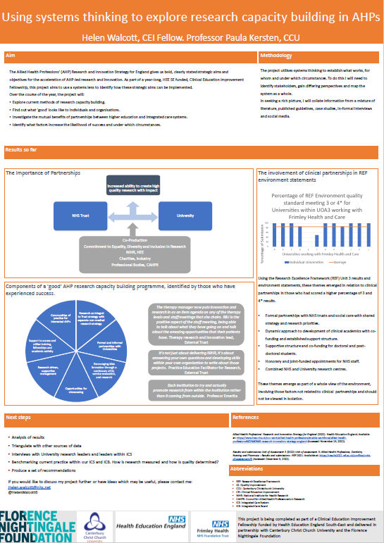
Using systems thinking to explore research capacity building in AHPs
Value & Impact of AHP engagement:
Building effective partnerships between universities and integrated care systems
Establishing what 'good' research capacity building looks like to both Universities and ICSs
Identify the mutual benefits of partnerships between higher education and integrated care systems
Professions: Physiotherapy
Contact: helen.walcott@nhs.net
Poster ID: 3, 8

Slide 28
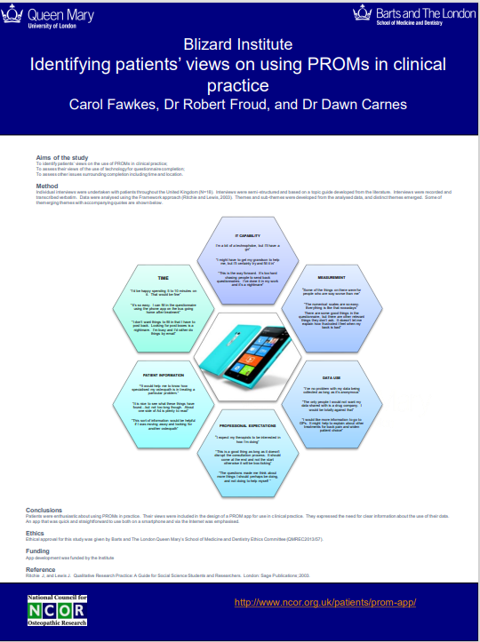
Identifying patients’ views on using PROMs in clinical practice
Poster ID: 3, 9
Value & Impact of AHP engagement:
Evidence of patients’ views on the use of outcome measures
Insights to patients’ perceptions of accessibility and acceptability of outcome measure collection
Professions: Osteopathy
Contact: Dawn.Carnes@uco.ac.uk

Slide 29
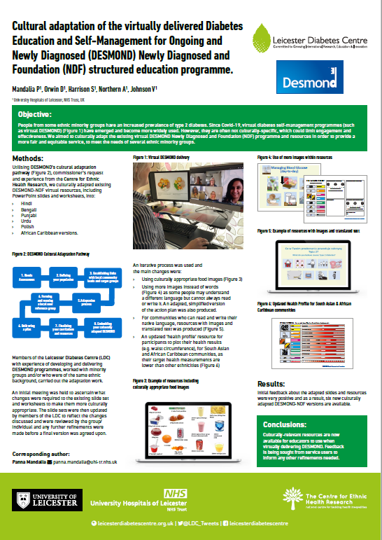
Cultural adaptation of the virtually delivered Diabetes Education and Self-Management for Ongoing and Newly Diagnosed (DESMOND) Newly Diagnosed and Foundation (NDF) structured education programme
Poster ID: 3, 10
Value & Impact of AHP engagement:
Co-production between local minority groups and the Leicester Diabetes Centre (LDC) team
Culturally-relevant resources developed for educators to deliver the DESMOND intervention online
Six new culturally adapted DESMOND-NDF versions now available
Professions: Dietetics, Nursing, Medicine, Physiotherapy
Contact: Vicki.Johnson@uhl-tr.nhs.uk

Slide 30
Celebrating the value and impact of AHP Research and Innovation!
Our Virtual Poster Gallery Brochure Themes
Evaluating student experiences and perceptions of research engagement
Promoting research engagement and capacity building in the wider workforce
Collaborative partnership working, including with service users
Building research capability, leadership and roles
Improving care quality & service delivery
Browse our Gallery Brochure
Note the Poster ID number
View the Posters in our Virtual Gallery

Slide 31
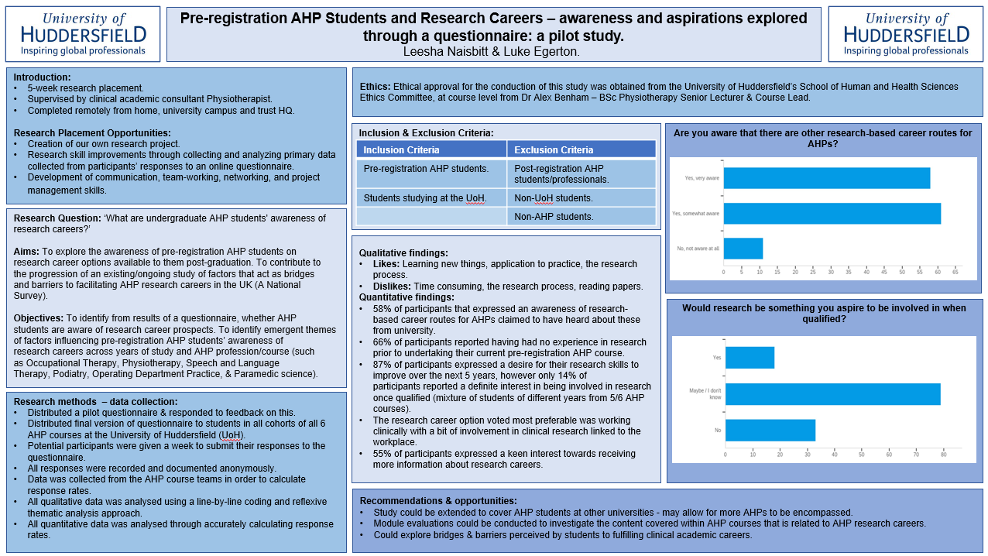
Pre-registration AHP Students and Research Careers - awareness and aspirations explored through a Questionnaire: a pilot study.
Poster ID: 4, 1
Value & Impact of AHP engagement:
Influence research and AHP career-related content delivered to pre-registration AHP students at the University of Huddersfield
Generated knowledge for use and implementation by academics and clinicians in pre-registration AHP students' placement provision
Created a basis which students completing subsequent research placements can build upon
Professions: Physiotherapy, Occupational Therapy, Speech and Language Therapy, Paramedic science, Podiatry, Operating Department Practitioners
Contact: leesha.naisbitt@gmail.com / adrian.robertson@nhs.net

Slide 32
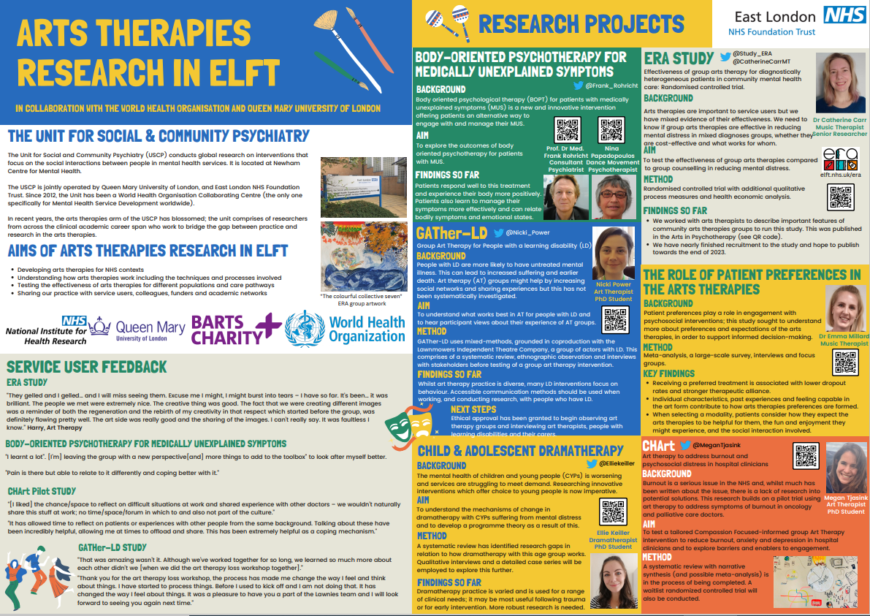
Arts Therapies Research in East London Foundation NHS Trust
Value & Impact of AHP engagement:
Our studies build an evidence base for arts therapies service development in the NHS
PhDs provide a springboard for future large scale research
Professions: Art Therapy, Drama Therapy, Music Therapy, Dance Movement Therapy
Contact: catherine.carr6@nhs.net
Poster ID: 4, 2

Slide 33
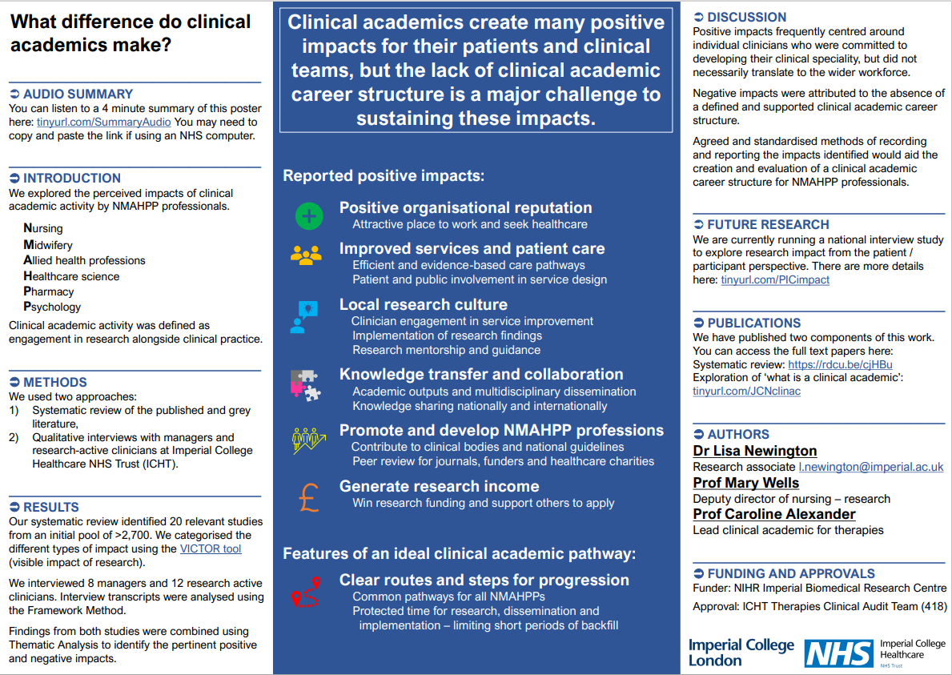
What difference do clinical academics make?
Value & Impact of AHP engagement:
Research active NMAHPPs were perceived to:
  create a positive reputation for their organisation,
  lead improvements to services,
  support local research culture,
  aid knowledge transfer and collaborations,
  promote and develop their profession
  generate research income.
The lack of a clinical academic career structure was identified as a major challenge to sustaining these impacts.
Professions: Physiotherapy, Speech and Language Therapy, Occupational Therapy, Radiography, Nursing, Clinical Research Practitioners
Contact: l.newington@imperial.ac.uk
Poster ID: 4, 3

Slide 34
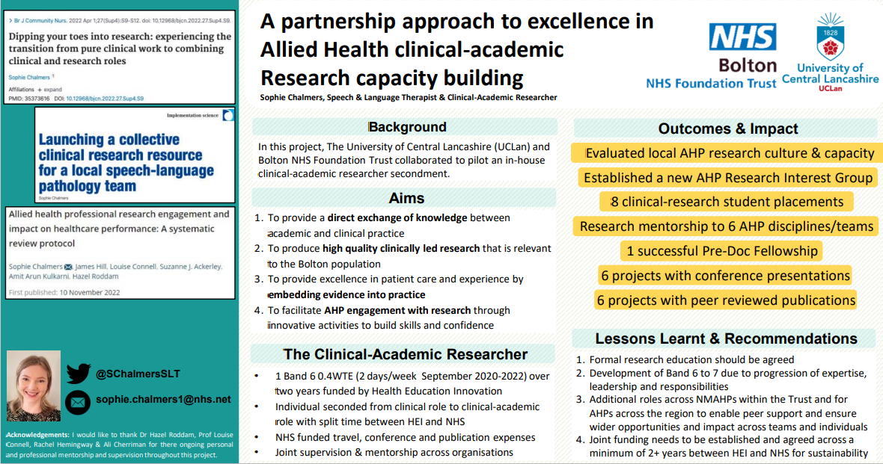
A partnership approach to excellence in Allied Health clinical-academic research capacity building
Value & Impact of AHP engagement:
Evaluated local AHP research culture & capacity
Research mentorship to 6 AHP disciplines/teams
Successful Pre-Doc Fellowship award
6 projects with peer reviewed publications
8 clinical-research student placements
Professions: Speech and Language Therapy
Contact: Sophie.Chalmers@boltonft.nhs.uk
Poster ID: 4, 4

Slide 35
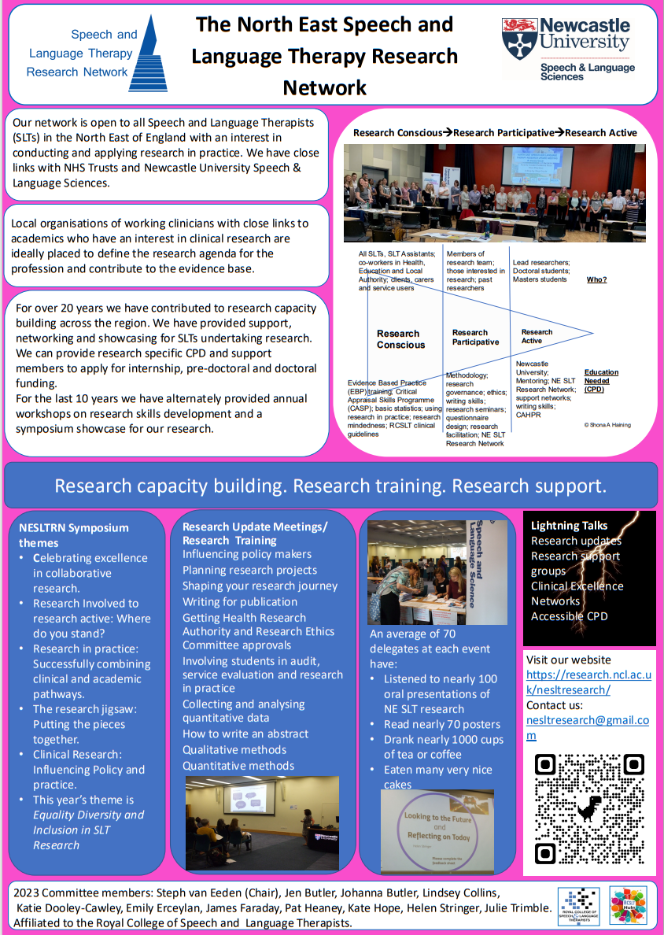
The North East Speech and Language Therapy Research Network
Poster ID: 4. 5
Value & Impact of AHP engagement:
Research capability and capacity building
Conducting and implementing research in practice
Professions: Speech and Language Therapy
Contact: helen.stringer@ncl.ac.uk on behalf of the NESLTRN Committee

Slide 36
Celebrating the value and impact of AHP Research and Innovation!
Our Virtual Poster Gallery Brochure Themes
Evaluating student experiences and perceptions of research engagement
Promoting research engagement and capacity building in the wider workforce
Collaborative partnership working, including with service users
Building research capability, leadership and roles
Improving care quality & service delivery
Browse our Gallery Brochure
Note the Poster ID number
View the Posters in our Virtual Gallery

Slide 37
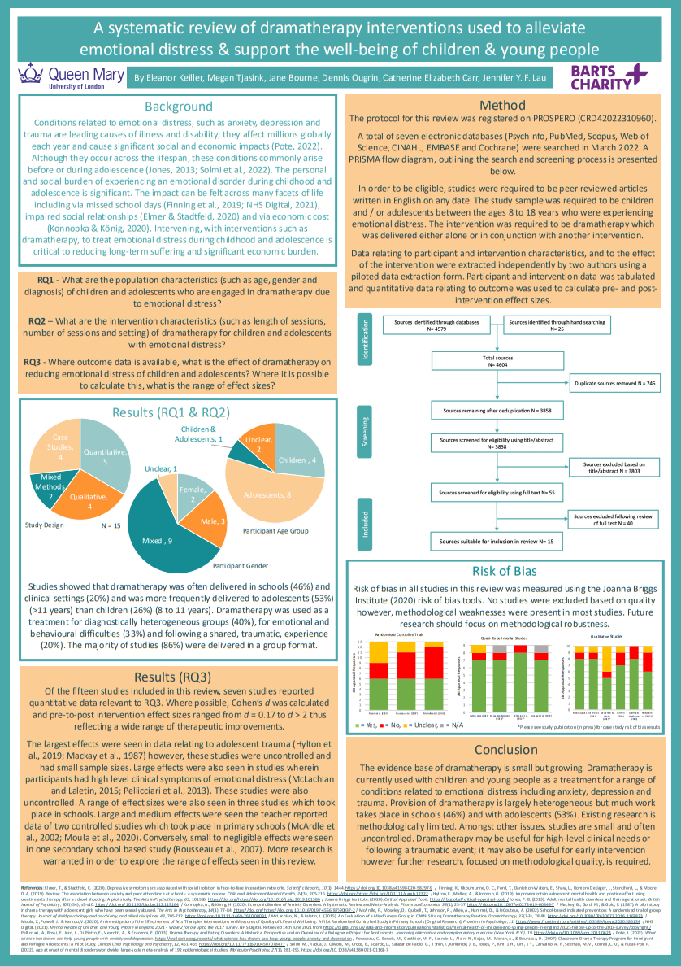
A systematic review of dramatherapy interventions used to alleviate emotional distress and support the well-being of children and young people aged 8 to 18 years old
Value & Impact of AHP engagement:
First review to explore existing evidence of dramatherapy for children and young people’s experience of emotional distress
Highlights key areas in which dramatherapy may be a potentially useful treatment
Illustrates existing methodological challenges in dramatherapy research and makes useful recommendations for future studies which seek to develop the evidence base of the field
Professions: Drama Therapy
Contact: elliekeiller@msn.com
Poster ID: 5, 1

Slide 38
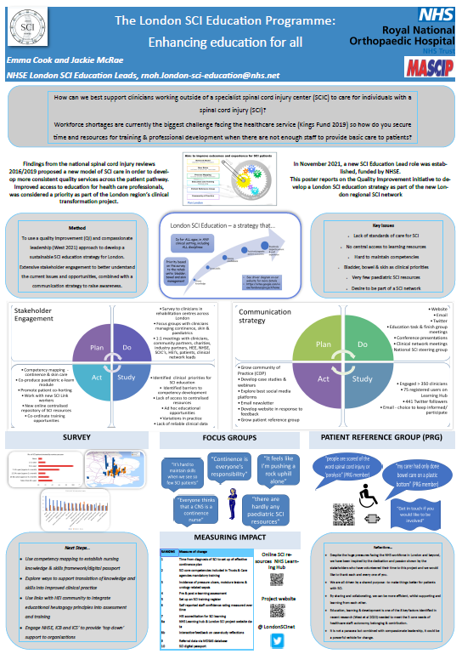
The London Spinal Cord Injury (SCI) Education Programme: Enhancing education for all
Value & Impact of AHP engagement:
Share the drivers for change in practice – enhancing knowledge and skills of all staff managing people with spinal cord injury across the patient pathway
Introduce an online learning platform that serves as a repository for standards, clinical guidelines and education resources
Create Communities of Practice to enable best practice and sustained change
Professions: Speech and Language Therapy, Physiotherapy
Contact: Jackie.mcrae1@nhs.net
Poster ID: 5, 2

Slide 39
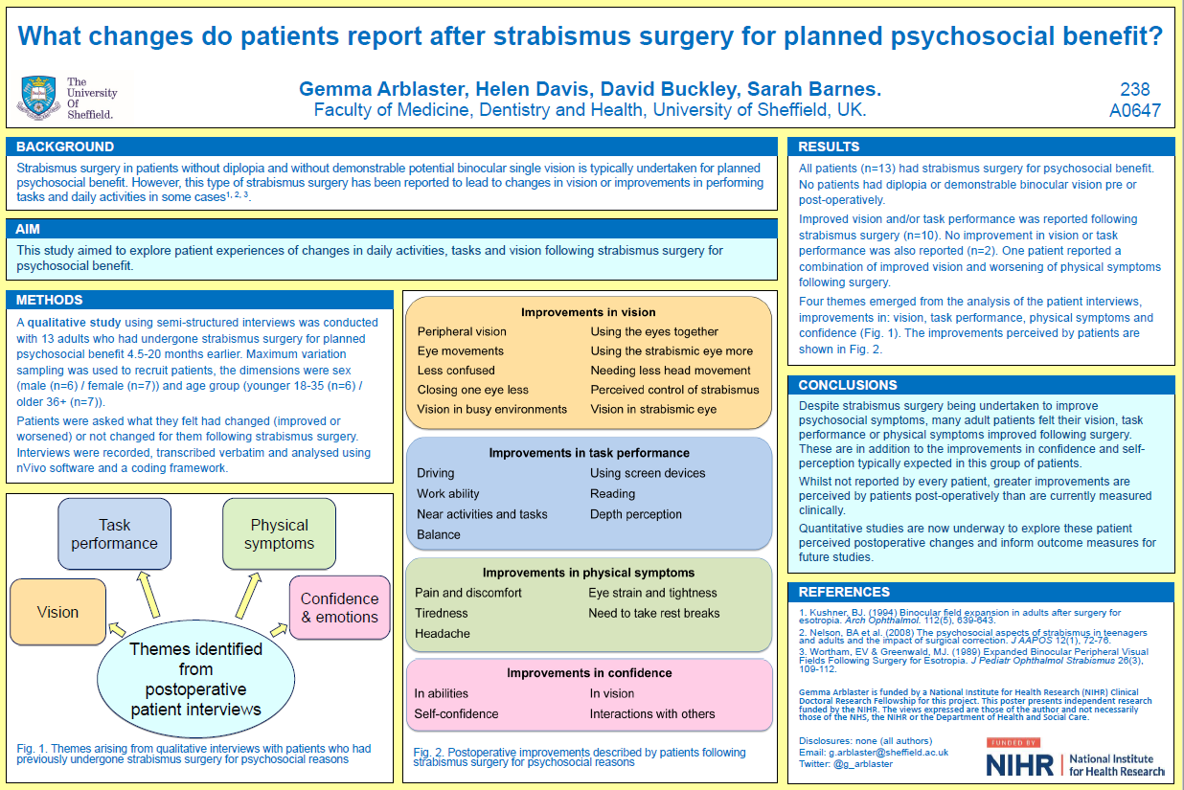
What changes do patients report after strabismus surgery for planned psychosocial benefit?
Value & Impact of AHP engagement:
Outcome measures for patient self-report post-surgery were developed and refined
Strabismus surgery for psychosocial reasons reported greater improvements postoperatively than were measured clinically
Further multi-centre collaborative research is planned
Professions: Orthoptists, Psychology, Public Health
Contact: K.Hanna2@liverpool.ac.uk
Poster ID: 5, 3

Slide 40
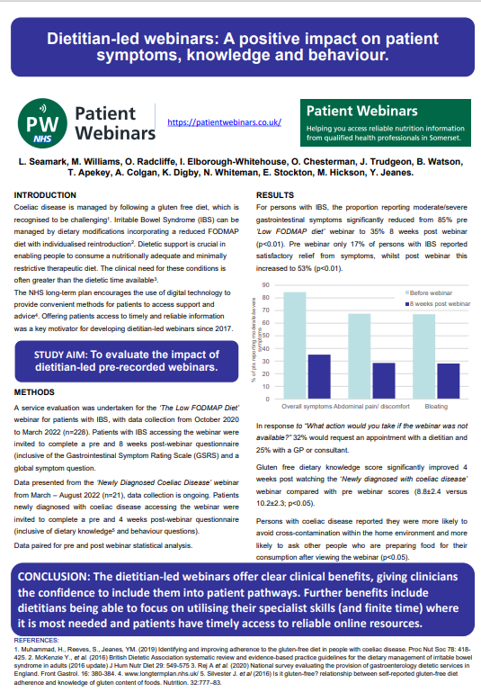
Dietitian-led webinars: A positive impact on patient symptoms, knowledge and behaviour.
Value & Impact of AHP engagement:
Evaluation of dietitian-led webinars demonstrated clinical benefit of digital resources (webinars) which are freely available
Improved patient outcomes (gastrointestinal symptoms)
increased clinician time
Provided timely and reliable information for patients.
Professions: Dietetics
Contact: Y.Jeanes@roehampton.ac.uk
Poster ID: 5, 4

Slide 41
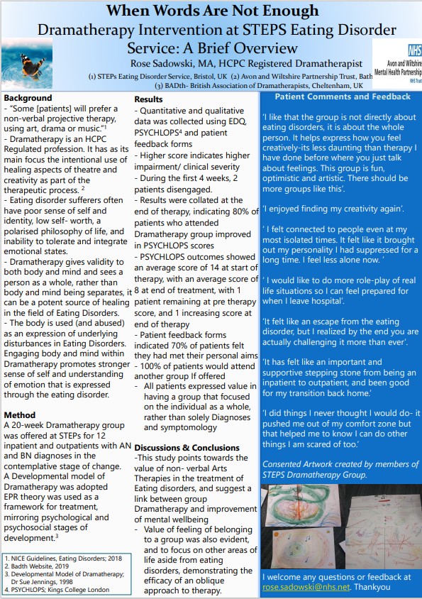
When Words Are Not Enough:
Dramatherapy Intervention at STEPS Eating Disorder Service: A Brief Overview
Value & Impact of AHP engagement:
Engaging the whole person within Dramatherapy promotes stronger sense of self and understanding of emotion that is expressed through the eating disorder
Evidence for an overall improvement of patient wellbeing at
the end of the intervention
Professions: Drama Psychotherapy
Contact: rose.sadowski@nhs.net
Poster ID: 5, 5

Slide 42
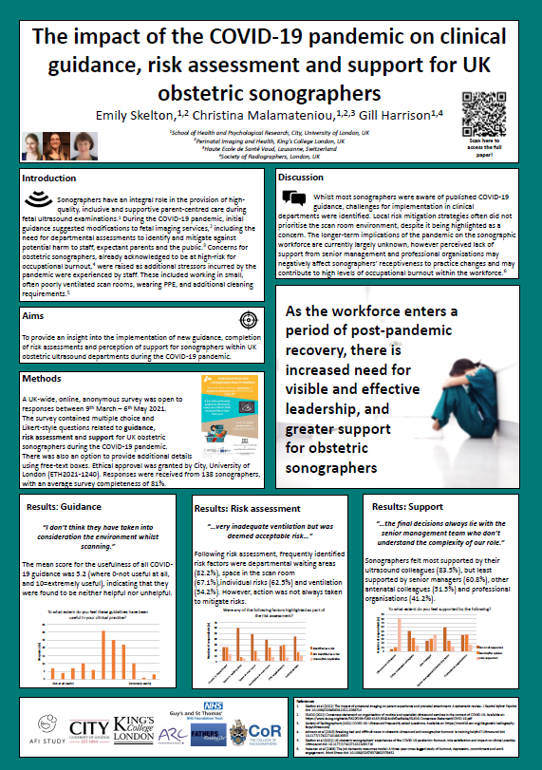
The impact of the COVID-19 pandemic on clinical guidance, risk assessment and support for UK obstetric sonographers
Poster ID: 5, 6
Value & Impact of AHP engagement:
Insights into workforce perceptions of delivering complex services
Evidence of the impact on staff teams of service delivery changes
Professions: Radiography, Sonography
Contact: christina.malamateniou@city.ac.uk

Slide 43
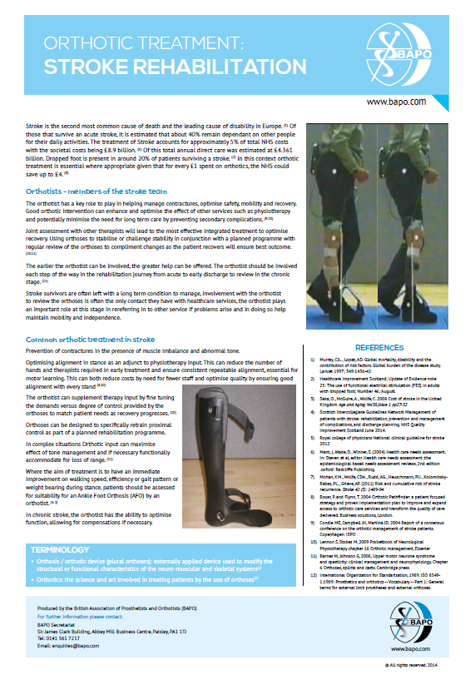
Orthotic Treatment - Stroke Rehabilitation
Value & Impact of AHP engagement:
Impact on services demonstrating benefit of orthotists involvement in post-stroke rehabilitation
Benefit for research on clinical practice leading to patient benefit
Professions: Prosthetists, Orthotists
Contact: Miriam.Golding-Day@bapo.com
Poster ID: 5, 7

Slide 44
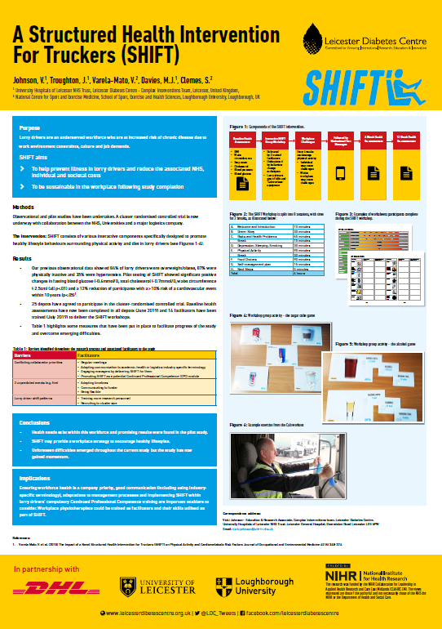
A Structured Health Intervention For Truckers (SHIFT)
Value & Impact of AHP engagement:
Effective multi-professional and cross-sector collaborative partnership working
Adaptations to management processes for workplace strategy
to encourage healthy lifestyles in the sector
Adoption into the lorry drivers’ compulsory Continued Professional Competence training
Professions: Physiotherapy, Dietetics, Logistics company managers
Contact: Vicki.Johnson@uhl-tr.nhs.uk
Poster ID: 5, 8

Slide 45
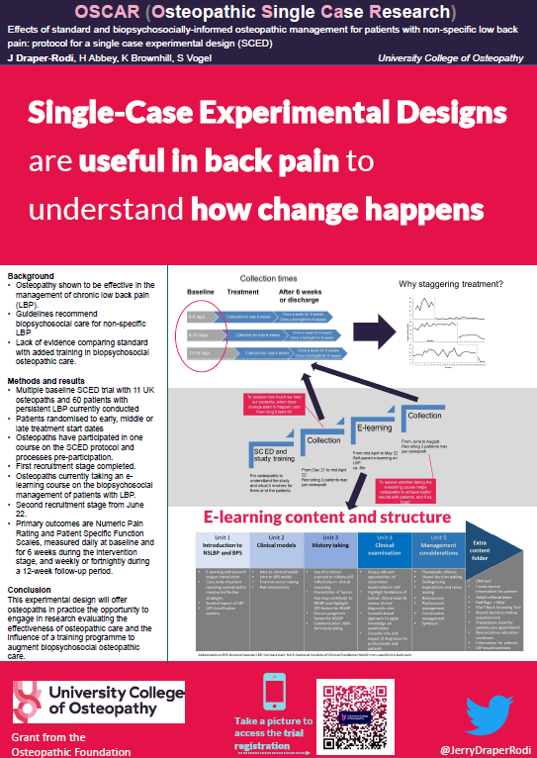
OSCAR (Osteopathic Single Case Research)
Effects of standard and biopsychosocially-informed osteopathic management for patients with non-specific low back pain: protocol for a single case experimental design (SCED)
Poster ID: 5, 9
Value & Impact of AHP engagement:
A new training programme to augment biopsychosocial osteopathic care
Opportunity for osteopaths in practice to engage in research evaluating the effectiveness of osteopathic care
Professions: Osteopathy
Contact: jerry.draper-rodi@uco.ac.uk

Slide 46
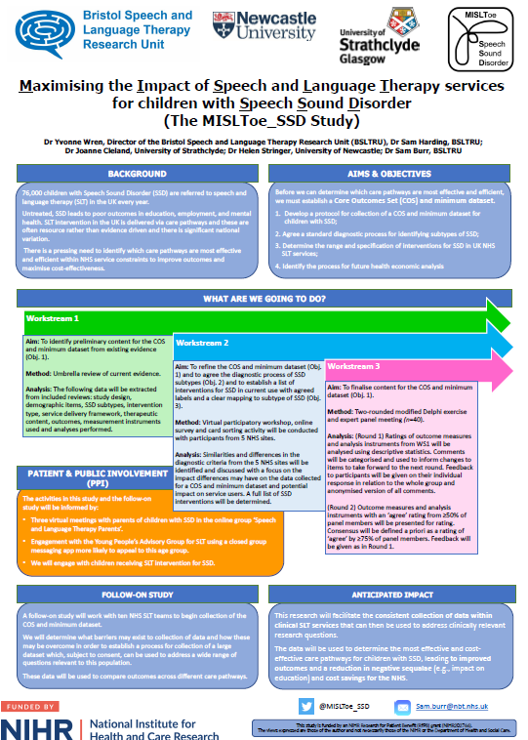
Maximising the Impact of Speech and Language Therapy for children with Speech Sound Disorder (MISLToe_SSD)
Value & Impact of AHP engagement:
A Core Outcome Set (COS) to drive collection of data from children with speech sound disorder in receipt of speech and language therapy
A Big Data set across UK services which can be used in investigations into effectiveness and efficiency of different treatments and patterns of service delivery
An important blueprint for research to develop COS for other patient populations in receipt of speech and language therapy
Professions: Speech and Language Therapy, Health Psychology
Contact: Sam.Burr@nbt.nhs.uk
Poster ID: 5, 10

