Slide 1
Introducing CATCH
www.catch.ac.uk
Tara Nadi
Medical Schools Council

Slide 2
What is CATCH?
The Clinical Academic Training & Careers Hub (CATCH) is a free, national online resource designed to make clinical academic careers easier to understand, navigate and access. CATCH brings together information that has historically been scattered across multiple organisations and systems.
The website includes:
Exploration of clinical academic career pathways
Training and development opportunities
Funding schemes and fellowship information
Case studies and interviews with clinical academics from across professions
Practical guidance and resources
CATCH is funded by:
British Heart Foundation
Cancer Research UK
Medical Schools Council
National Institute for Health and Care Research
Medical Research Council
Wellcome Trust

Slide 3
Why promote CATCH?
Promoting CATCH helps organisations raise awareness of clinical academic careers and ensures aspiring and early career clinical academics can access clear, consistent information about the profession.
Support staff who are exploring education, research or leadership as part of their career
A single, trusted place for colleagues to find information
Help reduce confusion around training routes and opportunities
Improve visibility of clinical academic options across multiple professions
Provide a resource that managers, supervisors and training leads can easily signpost
Help staff feel more informed and confident about their next steps

Slide 4

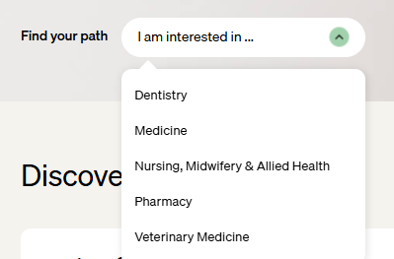

Share profession-specific career pages
Plans to expand to expand existing content including adding further professions.

Slide 5
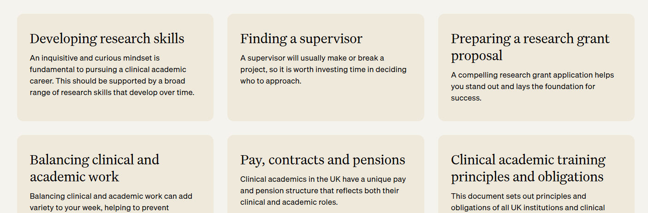
Use the Navigating your career section to support next steps

Slide 6
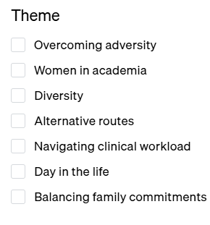
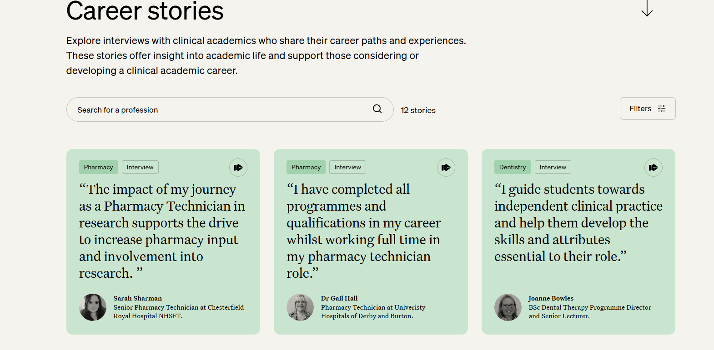
Encourage exploration of Career stories of clinical academics
Explore stories in the form of interviews and case studies
Filter by profession, career stage and/or theme

Slide 7
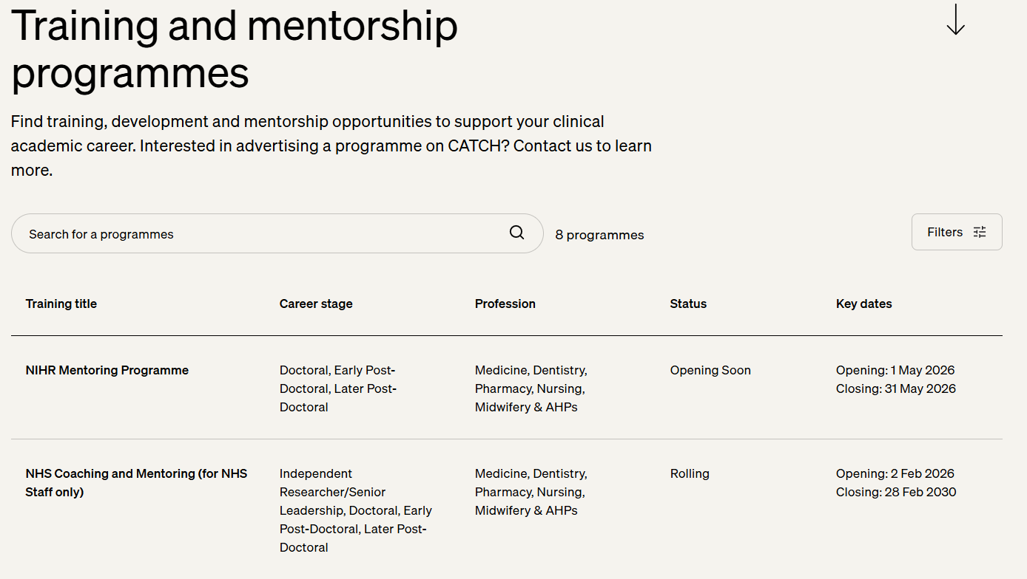
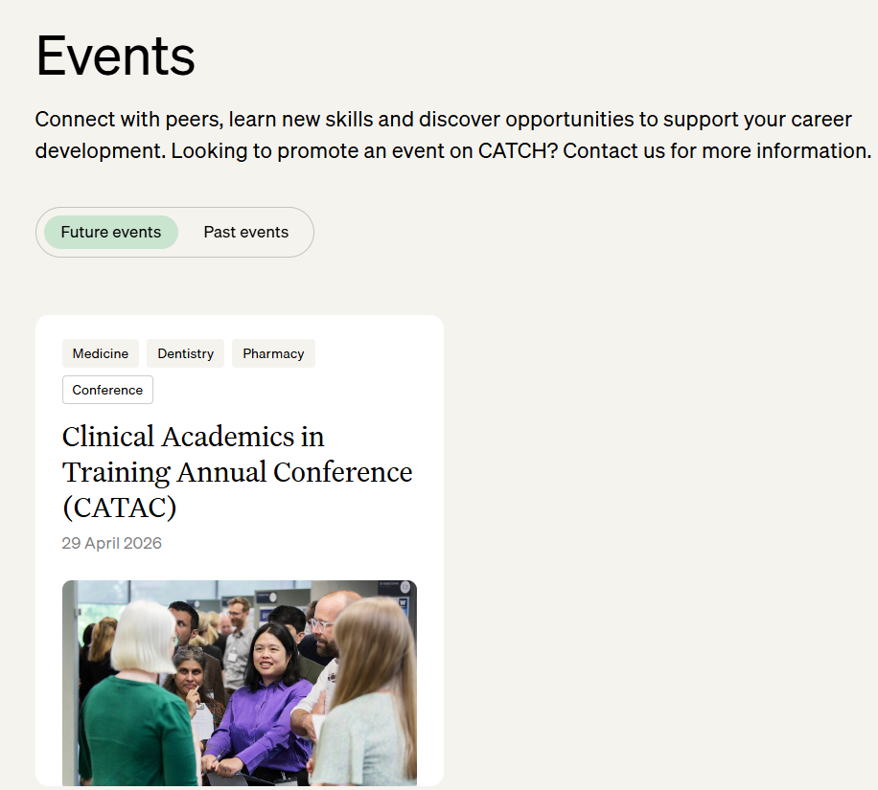
Explore and post events, training and mentorship programmes

Slide 8
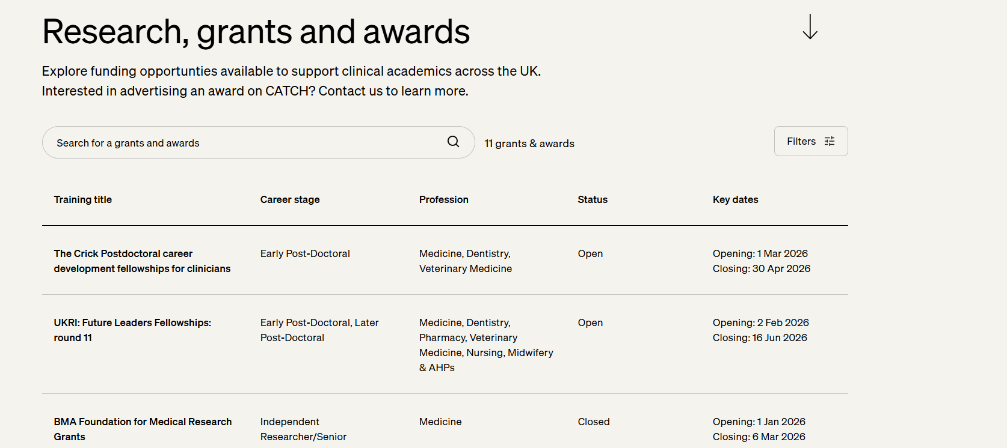
Explore and post funding opportunities

Slide 9
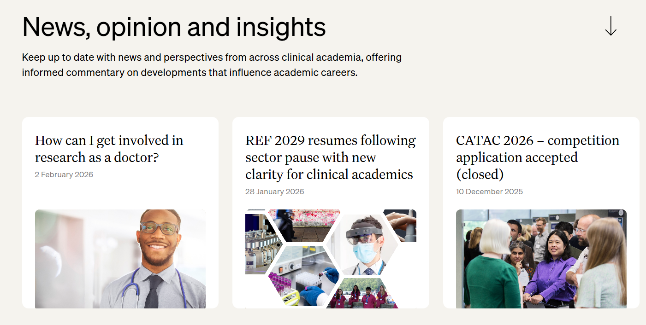
Keep informed around the latest developments in clinical academia

Slide 10
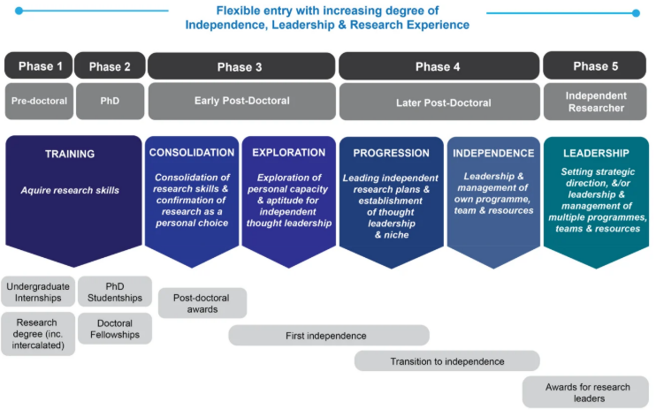
National clinical research pathway
Funders from across the UK have convened to map out funding for clinical researchers and develop proposals for simplifying career pathways.
Interactive and downloadable format available.

Slide 11
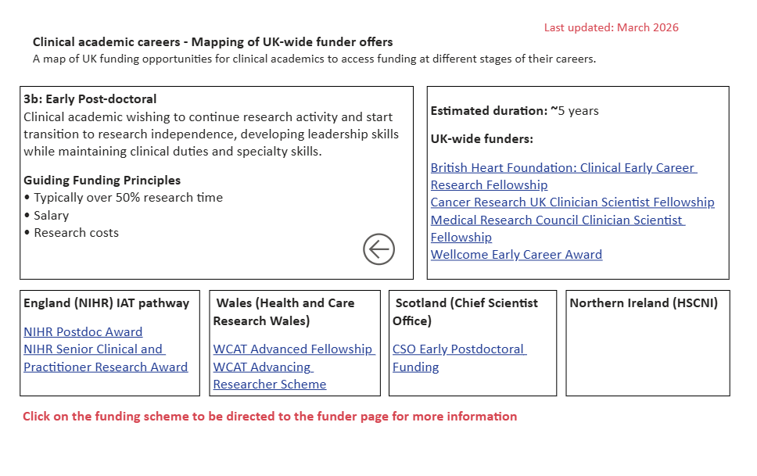
National clinical research pathway
Find the mapping on CATCH at:
www.catch.ac.uk/national-clinical-research-career-pathway

Slide 12
How you can support CATCH
Internal communications:
Include CATCH in staff bulletins, newsletters or intranet pages
Share information with research, education and workforce leads
Add CATCH to induction materials for new staff and trainees
Training & development:
Signpost CATCH in training sessions, study days or academic mentoring
Highlight CATCH during appraisal conversations
Include CATCH in professional development resources

Slide 13
How you can support CATCH
Public engagement:
Promote the website on your organisation’s social media channels
Encourage teams to share CATCH case studies
Display posters in staff areas or education centres
Web presence:
Add a link to CATCH from your organisation’s website
Reference CATCH in your research, training or workforce pages
Communications toolkit and assets available on request.

Slide 14
Posting on CATCH
Share opportunities
Have a funding call, training opportunity or event to promote? You can post it directly on CATCH.
Contribute your voice
Want to share a perspective or discuss a key issue? Submit an opinion piece or blog.
Share your career story
Help us build our interview library by submitting a case study or getting in touch to take part in an interview.
Help us improve CATCH
Have ideas for new content or improvements? We welcome your feedback. Join our content mailing list to stay involved and share suggestions.

Slide 15

Keep in touch
Instagram: instagram.com/catchclinicalacademia
Email: catch@medschools.ac.uk
Website: www.catch.ac.uk

